Slide 1


VAAGDEVI COLLEGE OF ENGINEERING
BASIC WEB PAGE USING HTML AND CSS
GANJI SAKETH REDDY (20641A6730)
ERRAM LIKHITH (20641A6725)
DANYAM SANTHOSHINI RUPA (20641A6720)
BANOTHU SHIREESHA (20641A6715)
ASMITHA ALLAMANENI (20641A6710)

Slide 2
INDEX
ABSTRACT
INTRODUCTION
SOFTWARE AND HARDWARE REQUIREMENTS
INPUT AND OUTPUT

Slide 3
ABSTRACT
This project is based on an idea of creating a Basic Home page for a Website
We created a home page for our college website with all the minimal knowledge we had.
This home page gives you an information regarding our college

Slide 4
INTRODUCTION
HTML is used to create web documents including text , images , formatting , and hyperlinks to other documents.
HTML documents consists of text and markup tags which are used to define the structure , appearance , and function of the information.
Cascading Style Sheets determines how the element can html document are displayed format
By using CSS we separate the content of Web page from the presentation of the content

Slide 5
FORMATING TOOLS
In this project we have used photoshop software for the background images
We Also used Anchor tag <A> for shifting the pages
We used type for keyframes
We used bootstrap software for the footer of the website

Slide 6
SOFTWARE AND HARDWARE REQUIREMENTS
Computer or PC
Windows 10 OS
Mac OS
Keyboard
Mouse
Virtual studio code
Notepad
Bootstrap
Adobe Photoshop
HTML
CSS

Slide 7
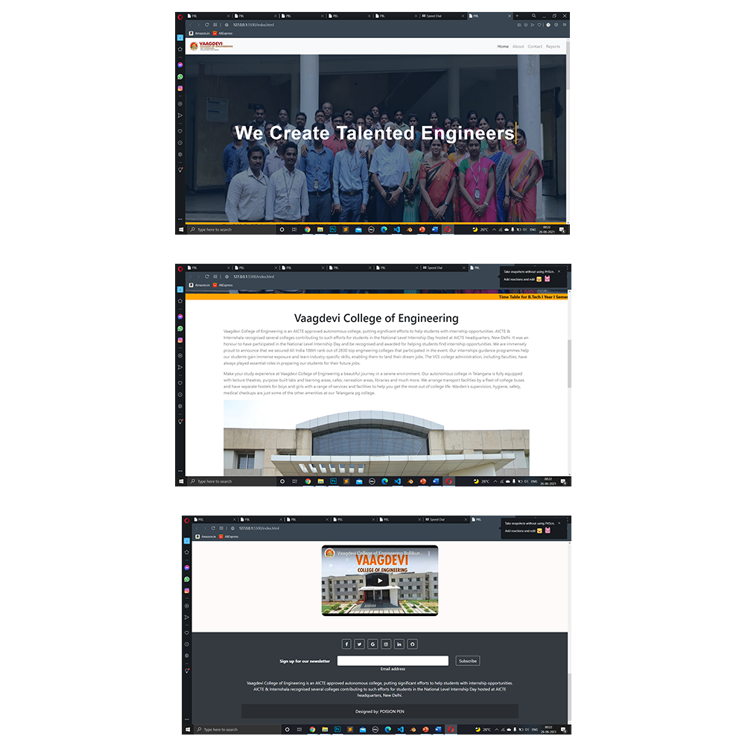
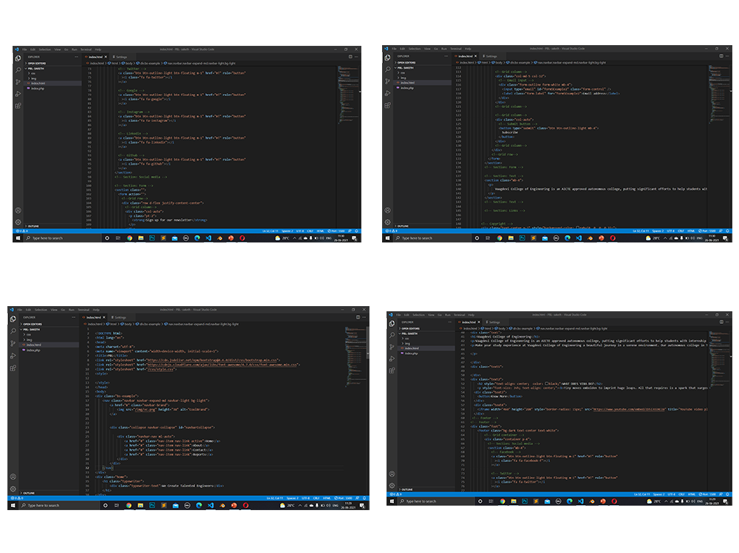
INPUT OUTPUT

Slide 8
CONCLUSION
By using HTML and CSS we can create a Web page.
html and CSS are interlinked with each other and we can create any type of Web pages and this languages are mostly useful for creating Web pages

Slide 9


